Slide 1

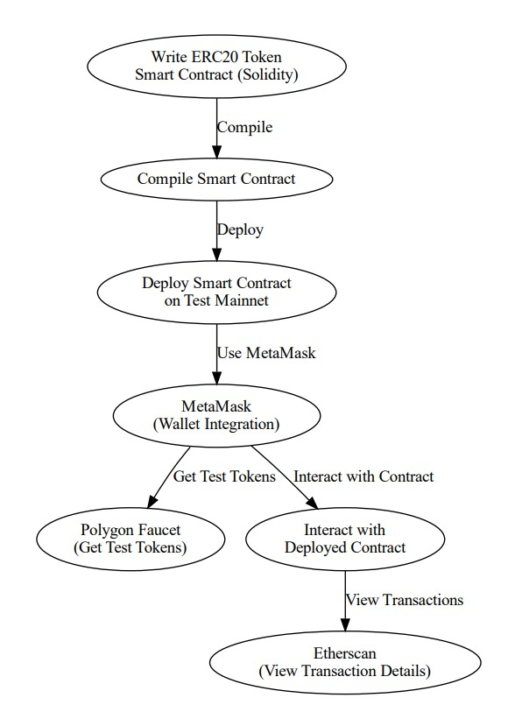
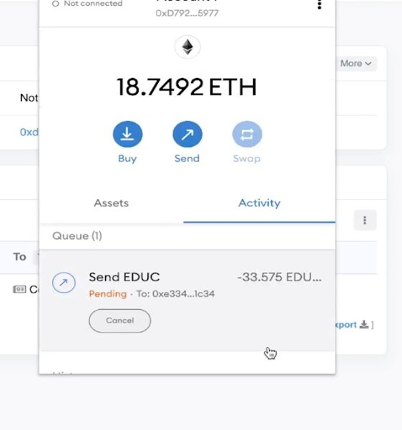
Ethereum Token Request and Comment 20
Students Team: A2 Guide: Prof. Shweta K.
Department: Electronics & Communication Engineering
Email IDs:02fe21bec019@klescet.ac.in; 02fe21bec021@klescet.ac.in; 02fe21bec042@klescet.ac.in; 02fe21bec064@klescet.ac.in;
Problem statement
Methodology
Results
Design and Implementation of an ERC20 Token on the Ethereum Blockchain.
Objectives
Create a Secure and Compliant ERC20 Token.
Enable Seamless Token Transfers and Approvals.
Facilitate Integration with Ethereum Ecosystem.
Facilitate User-Friendly Interaction.
Adopt Best Security Practices.
Contributions
Optimization details
Gas Efficiency: Use external functions, optimize storage layout, and reduce unnecessary state changes.
Security: Implement SafeMath, Pausable, and Ownable patterns.
Code Clarity: Maintain readability while combining related functionality and reducing redundant code.
Smart Contract Development
Token Design and Specification
Security Measures
Compliance and Legal Considerations:
Deployment and Testing
Literature survey
Conclusions
Ansari, Khalid Husain, and Umesh Kulkarni. "Implementation of ethereum request for comment (ERC20) Token." Proceedings of the 3rd International Conference on Advances in Science & Technology (ICAST). 2020.
Ansari, Khalid Husain, and Umesh Kulkarni. "Implementation of ethereum request for comment (ERC20) Token." Proceedings of the 3rd International Conference on Advances in Science & Technology (ICAST). 2020.
Ethereum blockchain demonstrates the feasibility of creating secure and compliant digital assets. It enables seamless token transfers and approvals, facilitating integration with the broader Ethereum ecosystem.
Minor Project-2: 2023-24

